Slide 1
205, Nov 9, Class 21
Final project proposals
Field Research, Cunningham (1989)

Slide 2
Final Projects
Aggression priming
Ashton, Kalycia, Sebastian
Color name preference
Isha, Niyati, Srikar
Emotional Words
Bari, Eva, Nico
Noise and Stroop
Minseo, Raoul, Renee, Sienna
Open-mindedness and Food
Aurea, Emily, Julie, Kyla
Status and Memory
Ethan, Laney, Laura, Minh

Slide 3
Field experiment
Cunningham (1989) trained several colleges students to approach opposite-sex bar patrons at random, delivering one of several different kinds of conversation-starters (“lines”). The positivity of each patron’s response to the line was surreptitiously measured.
Cunningham discovered that women were much more sensitive to the kind of line an opposite-sex person delivered than were men. Women responded more positively too lines that were either self-disclosing or ordinary, like a simple “Hi,” than they did to a flippantly delivered line such as “You remind me of someone I used to date” or “Bet I can outdrink you.”
Men, however, did not appear to care which kind of conversational gambit a woman used; they responded equally positively to all three.

Slide 4
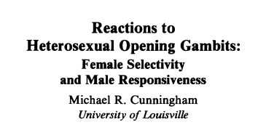
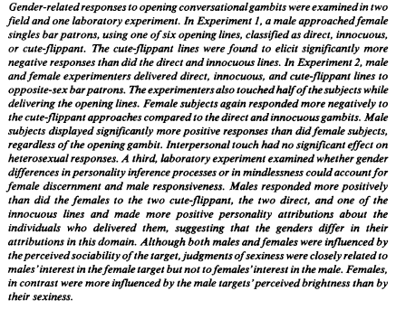


Slide 5
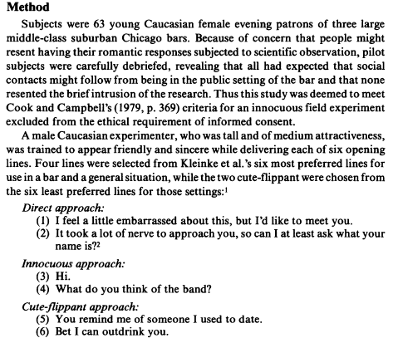
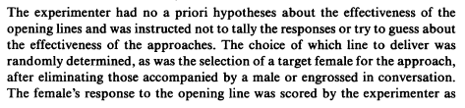
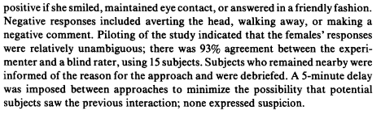
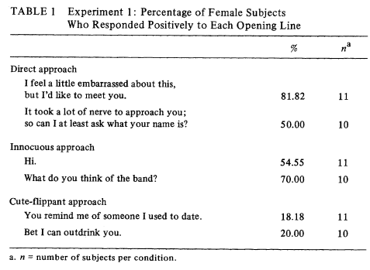

Slide 6
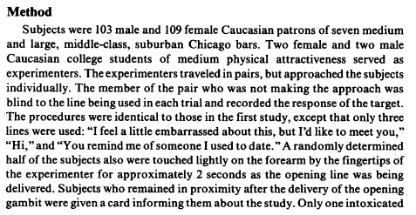
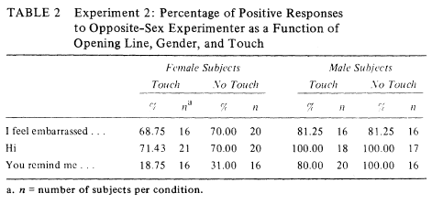

Slide 7
Field Research Procedures
Q1. The experimental report does not include information about the time of day when the data were collected for Experiments 1 or 2. One might imagine that responses to the “lines” might be different at 9pm and 1am.
Give 2 other extraneous variables that might affect the DV for these studies that should be considered in planning data collection.
Q2. How many participants total were run combined across Experiments 1 and 2? How many days/hours/trips to the bars do you think this would have taken?

Slide 8
Internal/External Validity
Q3. Experiment 3 provides a comparable procedure suitable for a well-controlled laboratory environment. How does this improve the internal validity of the results?
Q4. In what ways are Experiment 3 less effective than the field research with respect to external validity of the results?

Slide 9
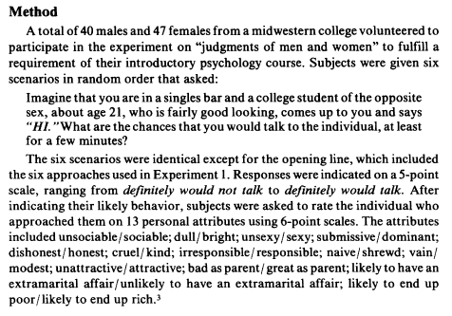
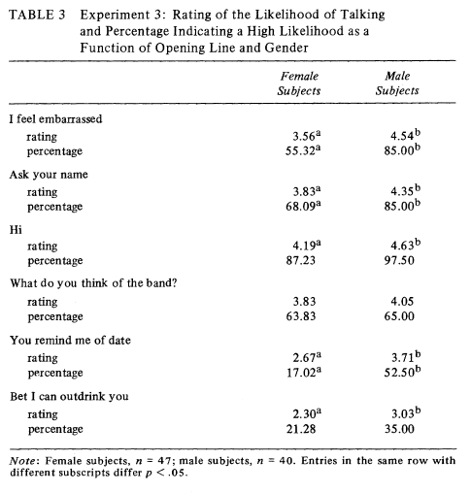

Slide 10
Q5. Experiment 1 includes the note:
“Because of concern that people might resent having their romantic responses subjected to scientific observation, pilot subjects were carefully debriefed, revealing that all had expected that social contacts might follow from being in the public setting of the bar and that non resenting the brief intrusion of the research. Thus this study was deemed to meet Cook and Campbell’s (1979, p. 369) criteria for an innocuous field experiment excluded from the ethical requirement of informed consent.”
This rational does not meet modern expectations for best practices for ethical research.
If one were to propose some similar research today, what ethical issues would you expect the IRB to raise and how might a researcher address those?

Slide 11
Field Research Summary
Quasi-experimental design
Manipulated independent variable
Done outside controlled laboratory conditions
Good external validity
Pretty good internal validity
Procedurally difficult to carry out
Many uncontrolled extraneous variables
Challenging to follow best practices for ethical research
Lack of voluntary participation, informed consent
Implicit deception

Slide 12
For Fri 11/11
Chapter 18: Ethics & Responsible Conduct of Research
Final project full proposal drafts
As soon as possible

